Slide 1
Lec.5 Functional Modeling
Instructor : Prashant Mishra
BIAS Bhimtal

Slide 2
Introduction
The functional model describes computations and specifies those aspects of the system concerned with transformations of values - functions, mappings, constraints, and functional dependencies. The functional model captures what the system does, without regard to how or when it is done.
The functional model is represented graphically with multiple data flow diagrams, which show the flow of values from external inputs, through operations and internal data stores, to external outputs. Data flow diagrams show the dependencies between values and the computation of output values from input values and functions. Functions are invoked as actions in the dynamic model and are shown as operations on objects in the object model.

Slide 3
DATA FLOW DIAGRAMS
“A data flow diagram is a graph which shows the flow of data values from their sources in objects through processes that transform them to their destinations in other objects”.
Data Flow Diagrams are commonly used during problem analysis. They are quite general and are not limited to problem analysis for software requirements specification. DFDs are very useful in understanding a system and can be effectively used during analysis.

Slide 4
A DFD shows the flow of data through a system. It views a system as a function that transforms the inputs into desired outputs. Any complex system will not perform this transformation in a "single step", and a data will typically undergo a series of transformations before it becomes the output. The DFD aims to capture the transformations that take place within a system to the input data so that eventually the output data is produced. The agent that performs the transformation of data from one state to another is called a process. So a DFD shows the movement of data through the different transformation or process in the system.

Slide 5
DFDs are basically of 2 types: Physical and logical ones.
Physical DFDs are used in the analysis phase to study the functioning of the current system.
Logical DFDs are used in the design phase for depicting the flow of data in a proposed system.

Slide 6
Data Flow Diagrams are composed of the four basic symbols –
External entities
Processes
Data stores
Data flow
• The External Entity symbol represents sources of data to the system or destinations of data from the system.
• The Process symbol represents an activity that transforms or manipulates the data (combines, reorders, converts, etc.).
• The Data Store symbol represents data that is not moving (delayed data at rest).
• The Data Flow symbol represents movement of data.

Slide 7

External Entity
The External Entity symbol represents sources of data to the system or destinations of data from the system. They determine the system boundary. They are external to the system being studied. They are often beyond the area of influence of the developer. They can represent another system or subsystem. These go on margins/edges of data flow diagram. They are represented by a rectangle symbol and are named with appropriate name as shown in Fig below.
Some authors call them actors as they are active objects that drive the data flow diagram by producing or consuming values. Actors are attached to the inputs and outputs of a data flow diagram. Actors are also called as terminators as they act as source and sink for data.

Slide 8

Processes
“The term process means all the computation activities that are involved from the input phase to the output phase”.
Processes are work or actions performed on incoming data flows to produce outgoing data flows. These show data transformation or change. Data coming into a process must be "worked on" or transformed in some way. Thus, all processes must have inputs and outputs. In some cases, data inputs or outputs will only be shown at more detailed levels of the diagrams. Each process is always "running" and ready to accept data. Major functions of processes are computations and making decisions.

Slide 9
A process is represented with the ellipse/circle symbol and the name of process is written in it. Each process has a fixed number of input and output data arrows, each of which carries a value of a given type. The inputs and outputs can be labeled to show their role in the computation. In Figure 2, two processes are shown. Here, you should note that a process can have more than one output. The display icon process represents the entire data flow diagram of Figure1 at a higher level of abstraction.
Every process is named. Processes are named with one carefully chosen verb and an object of the verb. There is no subject. Name is not to include the word "process“. Each process should represent one function or action. For example, get invoice, update customer and create Order.

Slide 10
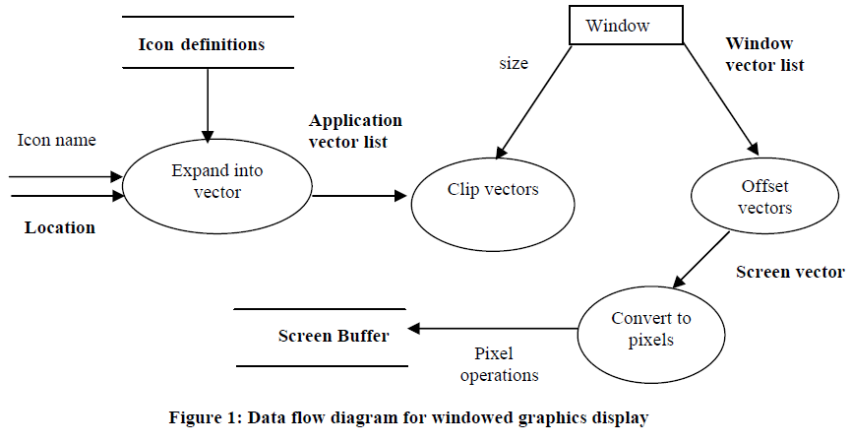

Slide 11
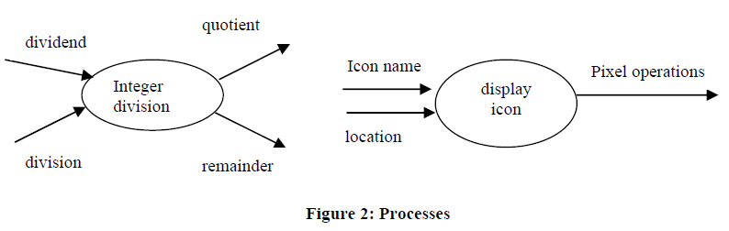

Slide 12
Data Flow
The term data flow literally means flow of data. A data flow connects the output of an object or process to the input of another object or process.
Data flow represents the input (or output) of data to (or from) a process, data store or an actor. Data flow only data, not control. Represent the minimum essential data the process needs. Using only the minimum essential data reduces the dependence between processes. Data flows must begin and/or end at a process.
Data flows are always named. Name is not to include the word "data". It should be given unique names. Names should be some identifying noun. For example, marks, order, payment, complaint, registration no.

Slide 13
A data flow is represented with the symbol arrow, and is used to connect the producer and the consumer of the data value. The arrow is labeled with a description of the data, usually, its name or type. The same value can be sent to several places and this is indicated by a fork with several arrows emerging from it. The output arrows are
unlabeled because they represent the same value as the input. Some data flows are shown in Figure 3 below.

Slide 14
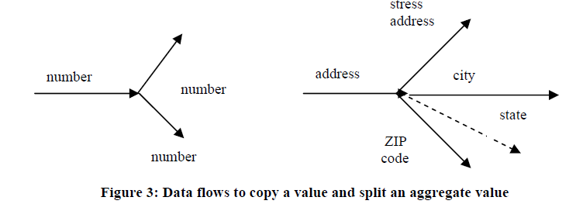

Slide 15
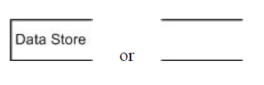
Data Store
Data stores are repository for data that are temporarily or permanently recorded within the system. It is an "inventory" of data. These are common link between data and process models. Only processes may connect with data stores.
Data stores are represented by open rectangle or two parallel lines as shown below.

Slide 16
Some of the examples of data stores are the database of airline seat reservations, a bank account, and a list of temperature readings over the past day.
A data store is represented by open rectangle or two parallel lines containing the name of the store.
Input arrows indicate information or operations that modify the stored data. Some of the operations which we can perform are adding elements, modifying values, or deleting elements. Output arrows indicate information retrieved from the store. This includes retrieving at the values, or some part of it.

Slide 17
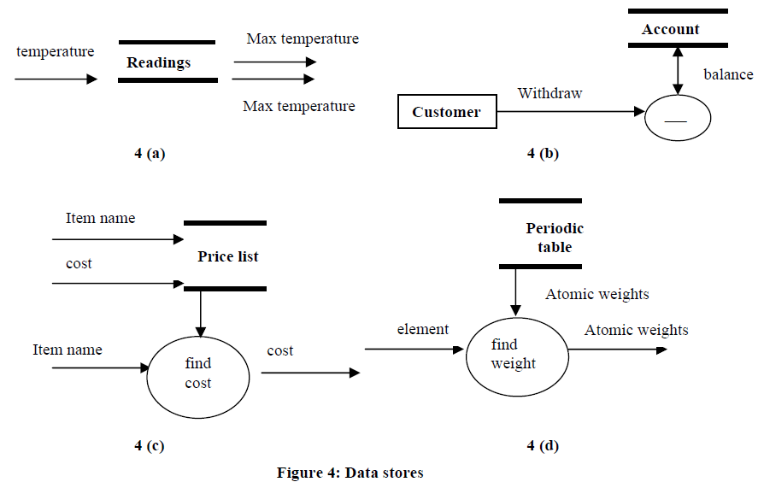

Slide 18
Figure 4 a shows a data stores for temperature readings. Every hour a new temperature reading enters the store. At the end of the day, the maximum and minimum readings are retrieved from the store. The data store permits many pieces of data to be accumulated so that the data can be used later on.
In Figure 4b data store for a bank account is given. The double-headed arrow indicates that a balance is both an input and an output of the subtraction operation. This can be represented with two separate arrows. Accessing and updating of the value in a data store is a common operation.
In Figure 4c, a price list for items is shown. Input to the store consists of pairs of item name and cost values. Later, an item is given, and the corresponding cost is found. The unlabeled arrow from the data store to the process indicates that the entire price list is an input to the selection operation.
To find the atomic weight of an element from a periodic table we can use a data flow diagram. This data flow diagram is represented in Figure 4d. Obviously, the properties of chemical elements are constant and not a variable of the program. It is convenient to represent the operation as a simple access of a constant data store object. Such a data store has no inputs.

Slide 19
Control Flow
Control flow is a Boolean value in the DFD that affects whether a process is evaluated or not. The control flow is not an input value to the process. It is represented by a dotted line from a process originating the Boolean value to the process being controlled as shown in fig below. This DFD is for a withdrawal from a bank account. The customer supplies a password and an amount. The update (withdrawal) can occur only when password is OK, which is shown as control flow in the diagram.

Slide 20
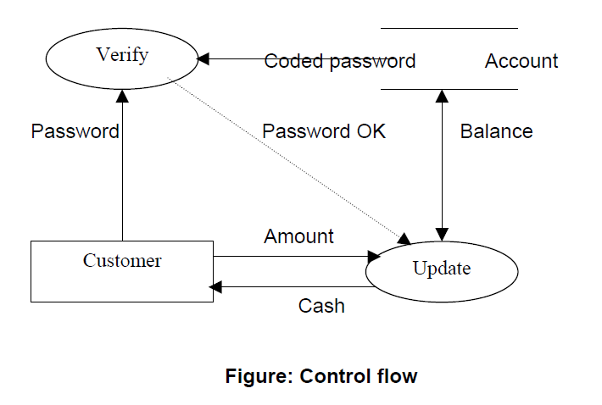

Slide 21
Constraints
A constraint shows the relationship between two objects at the same time, or between different values of the some object at different times.
For example, in coordinate geometry, the location of a point can be obtained by finding the x and y coordinates, and the scale of these two system of coordinates can be the same or different.
Constraints can appear in each kind of model. Object constraints describe where some objects depend entirely or partially on other objects. Dynamic constraints represent relationships among the states or events of different objects. Similarly, the functional constraints shows the restrictions on operations, such as the scaling transformation.

Slide 22
Data Dictionary and Meta Data
In the data flow diagrams, we have given names to data flows, processes and data stores. Although the names are descriptive of the data, they do not give details. So following the DFD, the interest is to build some structures place to keep details of the contents of data flows, processes and data stores. Here comes the concept of data dictionary.

Slide 23
A data dictionary is a structured repository of data about data. It is a set of rigorous definitions of all DFD data elements and data structures. To define the data structure, different notations are used.

Slide 24
Meta Data
It is loosely defined as data about data.
Metadata is a concept that applies mainly to electronically archived or presented data and is used to describe the: a) definition, b) structure and c) administration of data files with all contents in context to ease the use of the captured and archived data for further use. For example, a web page may include metadata specifying what language it‘s written in, what tools were used to create it, where to go for more on the subject and so on.

Slide 25
Metadata is defined as data providing information about one or more other pieces of data, such as:
means of creation
purpose of the data
time and date of creation
creator or author of data
placement on a network (electronic form) where the data was created,
What standards used etc.

Slide 26
For example: A digital image may include metadata that describes how large the picture is, the color depth, the image resolution, when the image was created, and other data. A text document's metadata may contain information about how long the document is, who the author is, when the document was written, and a short summary of the document.

Slide 27
There are three main types of metadata:
Descriptive metadata: It describes a resource for purposes such as discovery and identification. It can include elements such as title, abstract, author, and keywords.
Structural metadata: It indicates how compound objects are put together, for example, how pages are ordered to form chapters.
Administrative metadata: It provides information to help manage a resource, such as when and how it was created, file type and other technical information, and who can access it.

Slide 28
Steps to Produce a DFD
• Identify and list external entities providing inputs/receiving outputs from system
• Identify and list inputs from/outputs to external entities
• Draw a context DFD

Slide 29
Rules for Drawing DFDs
• A process must have at least one input and one output data flow
• A process begins to perform its tasks as soon as it receives the necessary input data flows
• A primitive process performs a single well-defined function
Never label a process with an IF-THEN statement
• Never show time dependency directly on a DFD
• Be sure that data stores, data flows, data processes have descriptive titles.
Processes should use imperative verbs to project action.
• All processes receive and generate at least one data flow.
• Begin/end data flows with a bubble.

Slide 30
Rules for Data Flows
• A data store must always be connected to a process.
• Data flows must be named.
• Data flows are named using nouns Customer ID, Student information.
• Data that travel together should be one data flow.
• Data should be sent only to the processes that need the data.

Slide 31
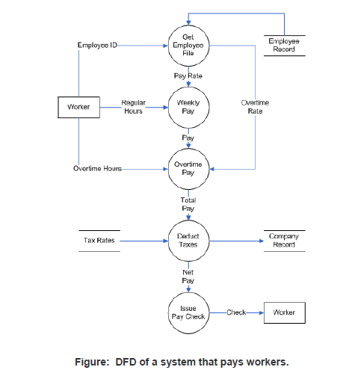
Examples of DFDs

Slide 32
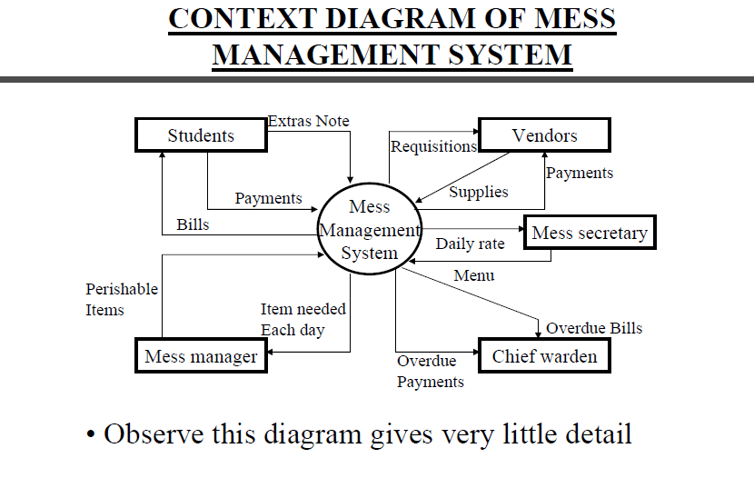

Slide 33
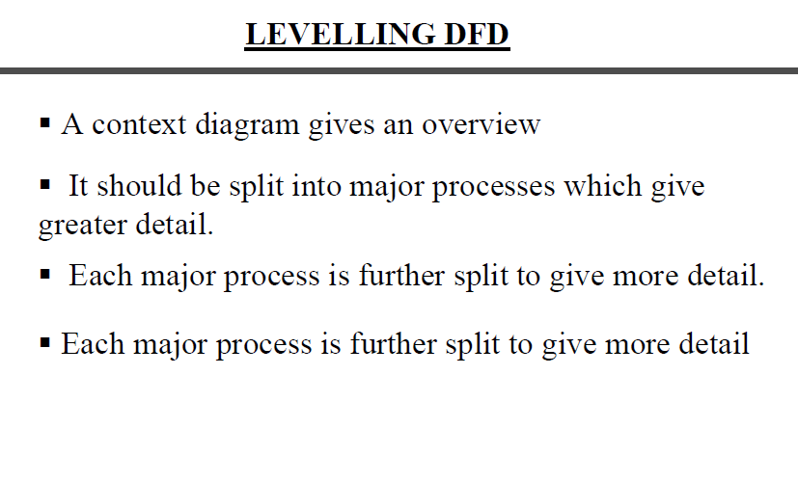

Slide 34
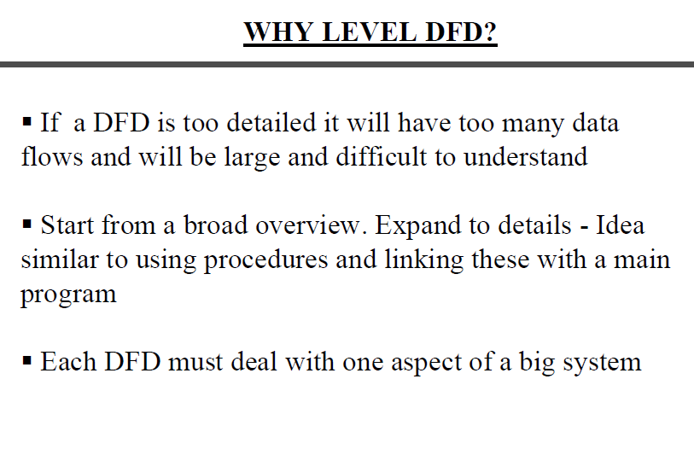

Slide 35
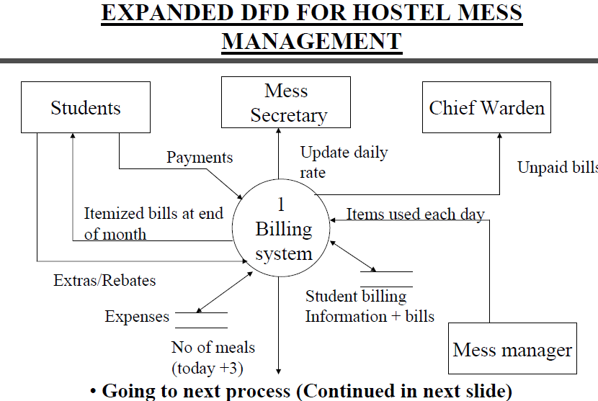

Slide 36
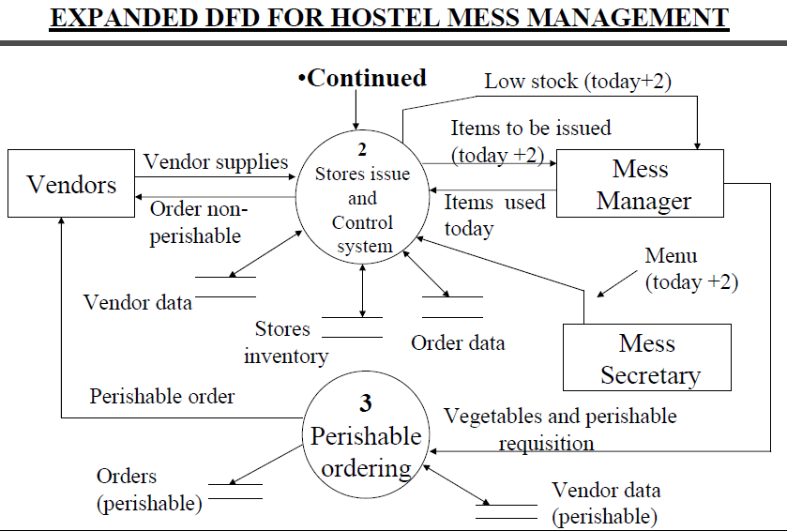

Slide 37
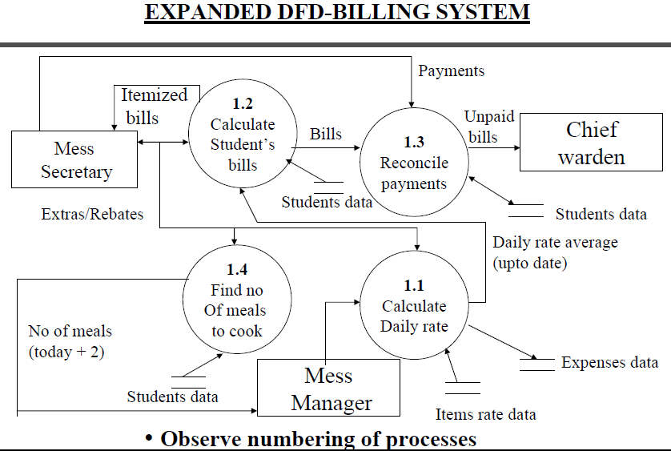

Slide 38
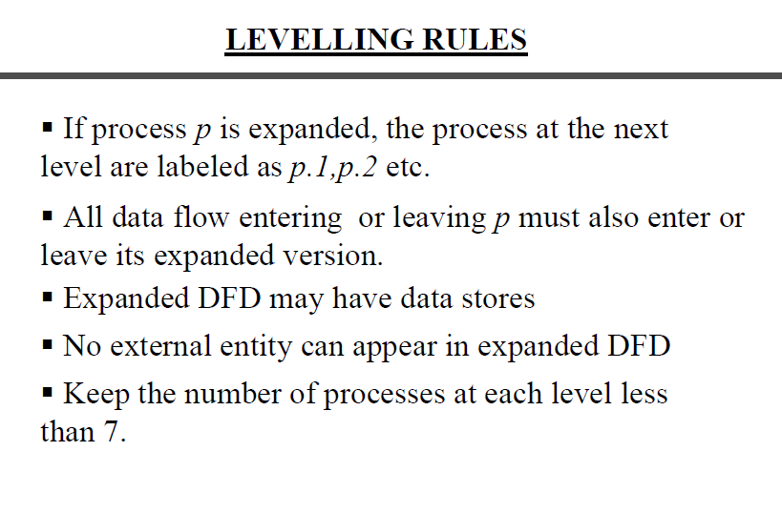

Slide 39
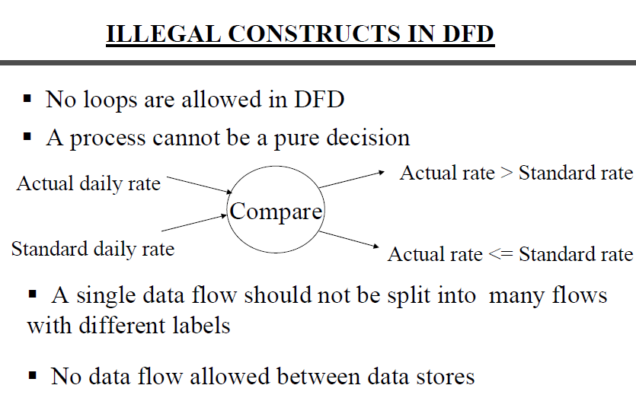

Slide 40
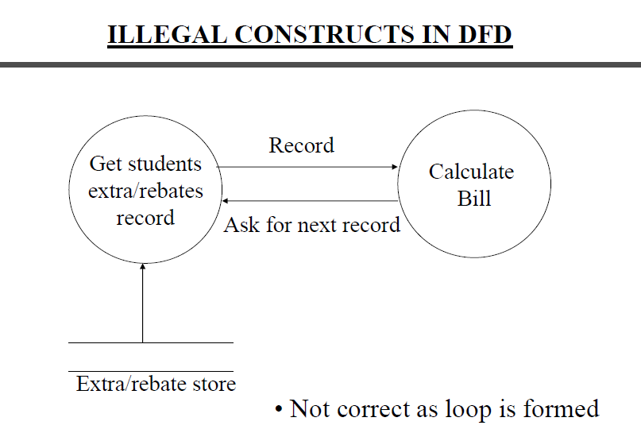

Slide 41
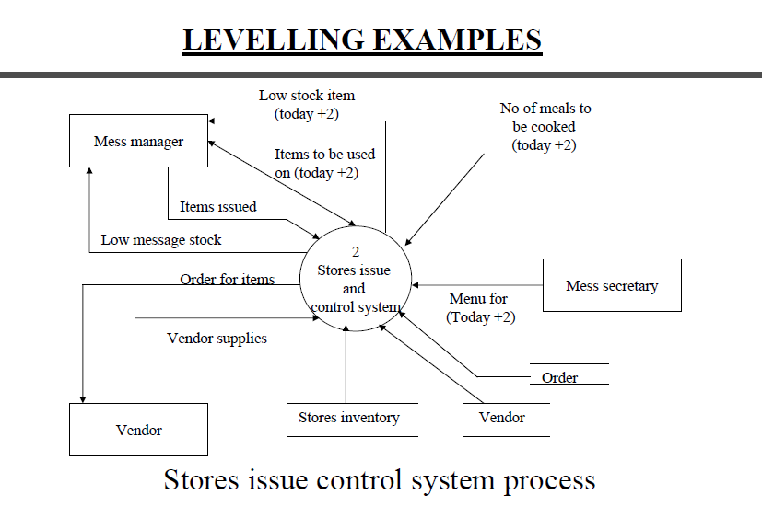

Slide 42
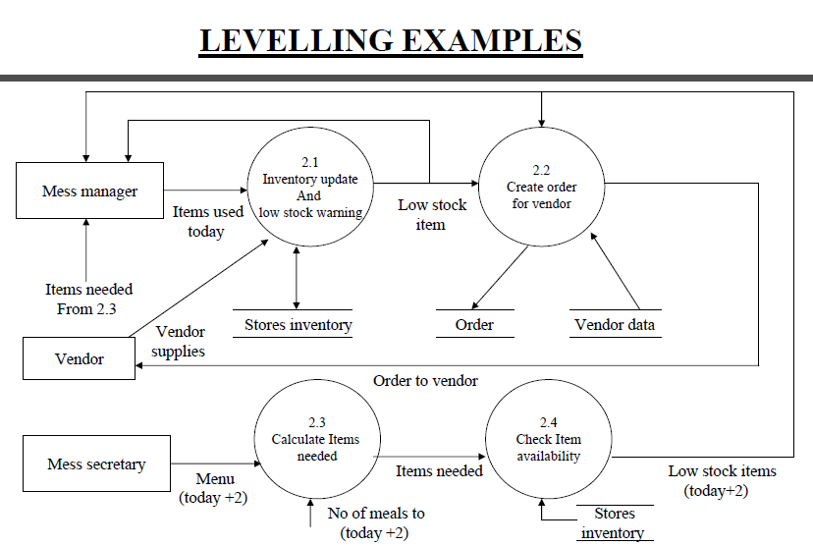

Slide 43
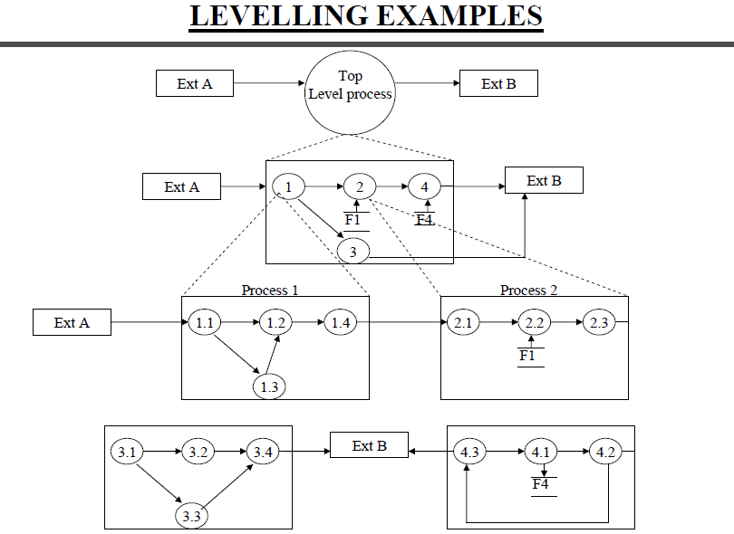

Slide 44
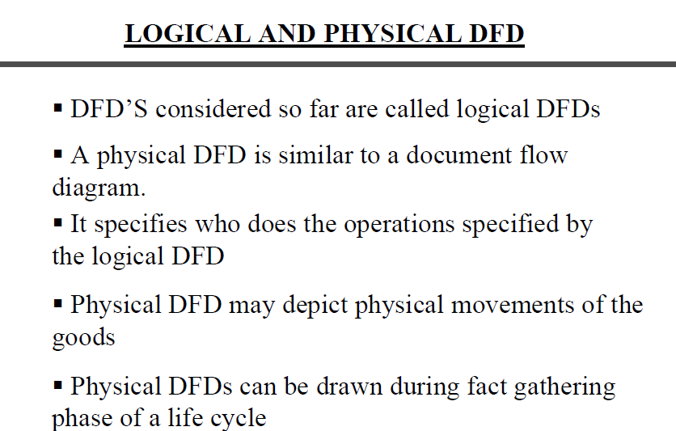

Slide 45
Logical and Physical Data Flow Diagrams
Data flow diagrams are categorized as either logical or physical. A logical data flow diagram focuses on the business and how the business operates. It is not concerned with how the system will be constructed. Instead, it describes the business events that take place and the data required and produced by each event. Conversely, a physical data flow diagram shows how the system will be implemented, including the hardware, software, files, and people involved in the system. The chart shown below contrasts the features of logical and physical models. Notice that the logical model reflects the business, whereas the physical model depicts the system.

Slide 46
Design Feature | Logical | Physical
What the model depicts | How the business operates. | How the system will be implemented (or how the current system operates).
What the processes represent | Business activities. | Programs, program modules, and manual procedures.
What the data stores represent | Collections of data regardless of how the data are stored. | Physical files and databases, manual files.
Type of data stores | Show data stores representing permanent data collections. | Master files, transition files. Any processes that operate at two different times must be connected by a data store.
System controls | Show business controls. | Show controls for validating input data, for obtaining a record (record found status), for ensuring successful completion of a process, and for system security (example: journal records).

Slide 47
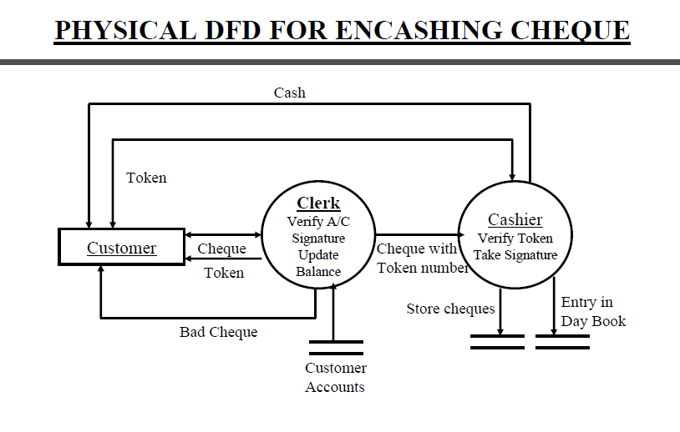

Slide 48
